Slide 1
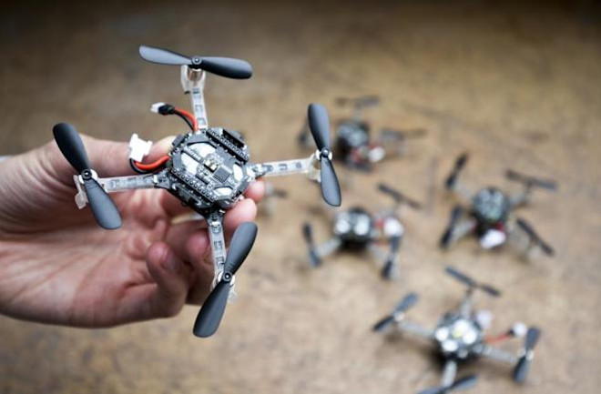
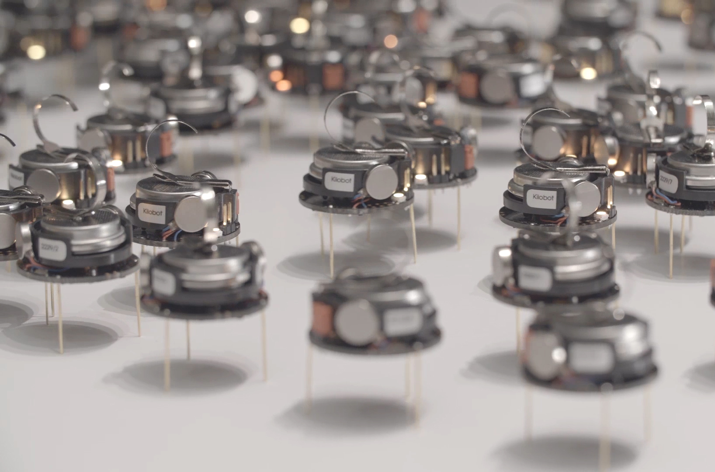
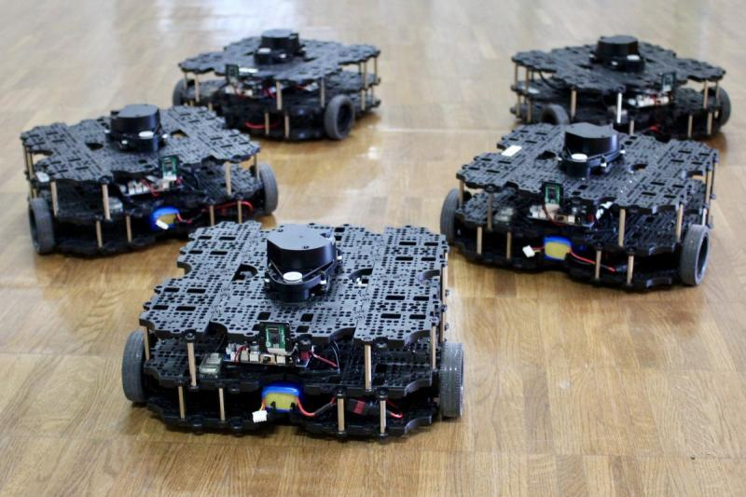

ECE693H, Spring 2025: Multi-robot System Design
“Autonomous Mobile Robots”
Dr. Daniel Drew

Slide 2
Multi-robot Systems

Slide 3
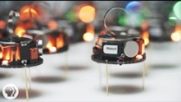
Multi-robot Systems

Slide 4
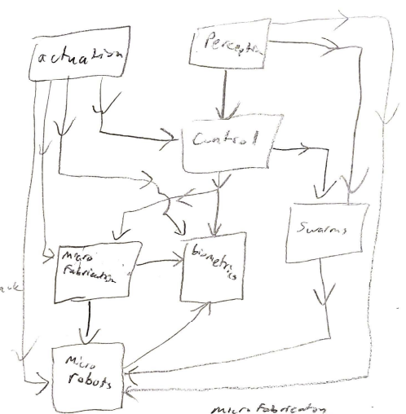
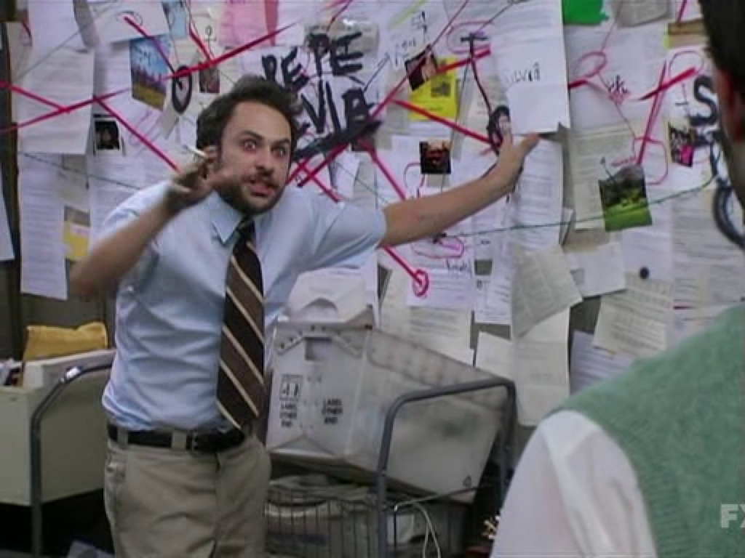
Course One-Pager: Robot Design Schematic
Hierarchy and structure in these conceptual diagrams is hard!
In general, as with most engineering problems, work from constraints

Slide 5
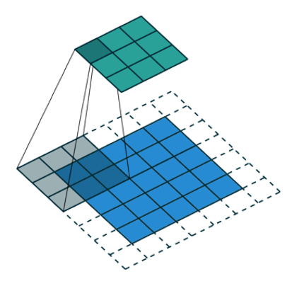
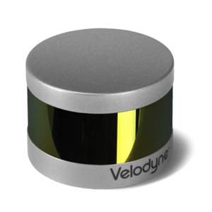
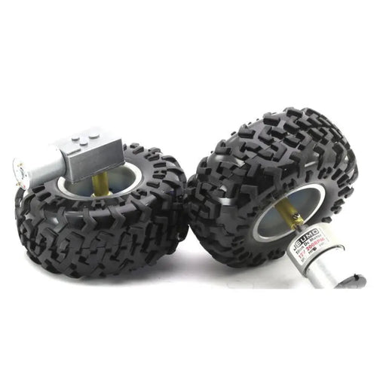
Pillars of Robotics
Action
Perception
Intelligence
(not just moving)
(not just sensing)
(not just classification)

Slide 6
Pillars of Robotics: Action
Modality: Ground? Air? Water?
Base: Wheels? Treads? Legs?
Transmission: Direct drive? Gearbox? Belt?
Action
Steering: Differential? Ackermann? Omni?
RPM: PID? LQR? MPC?
Motion planning: Cascaded PID? Model-based?

Slide 7
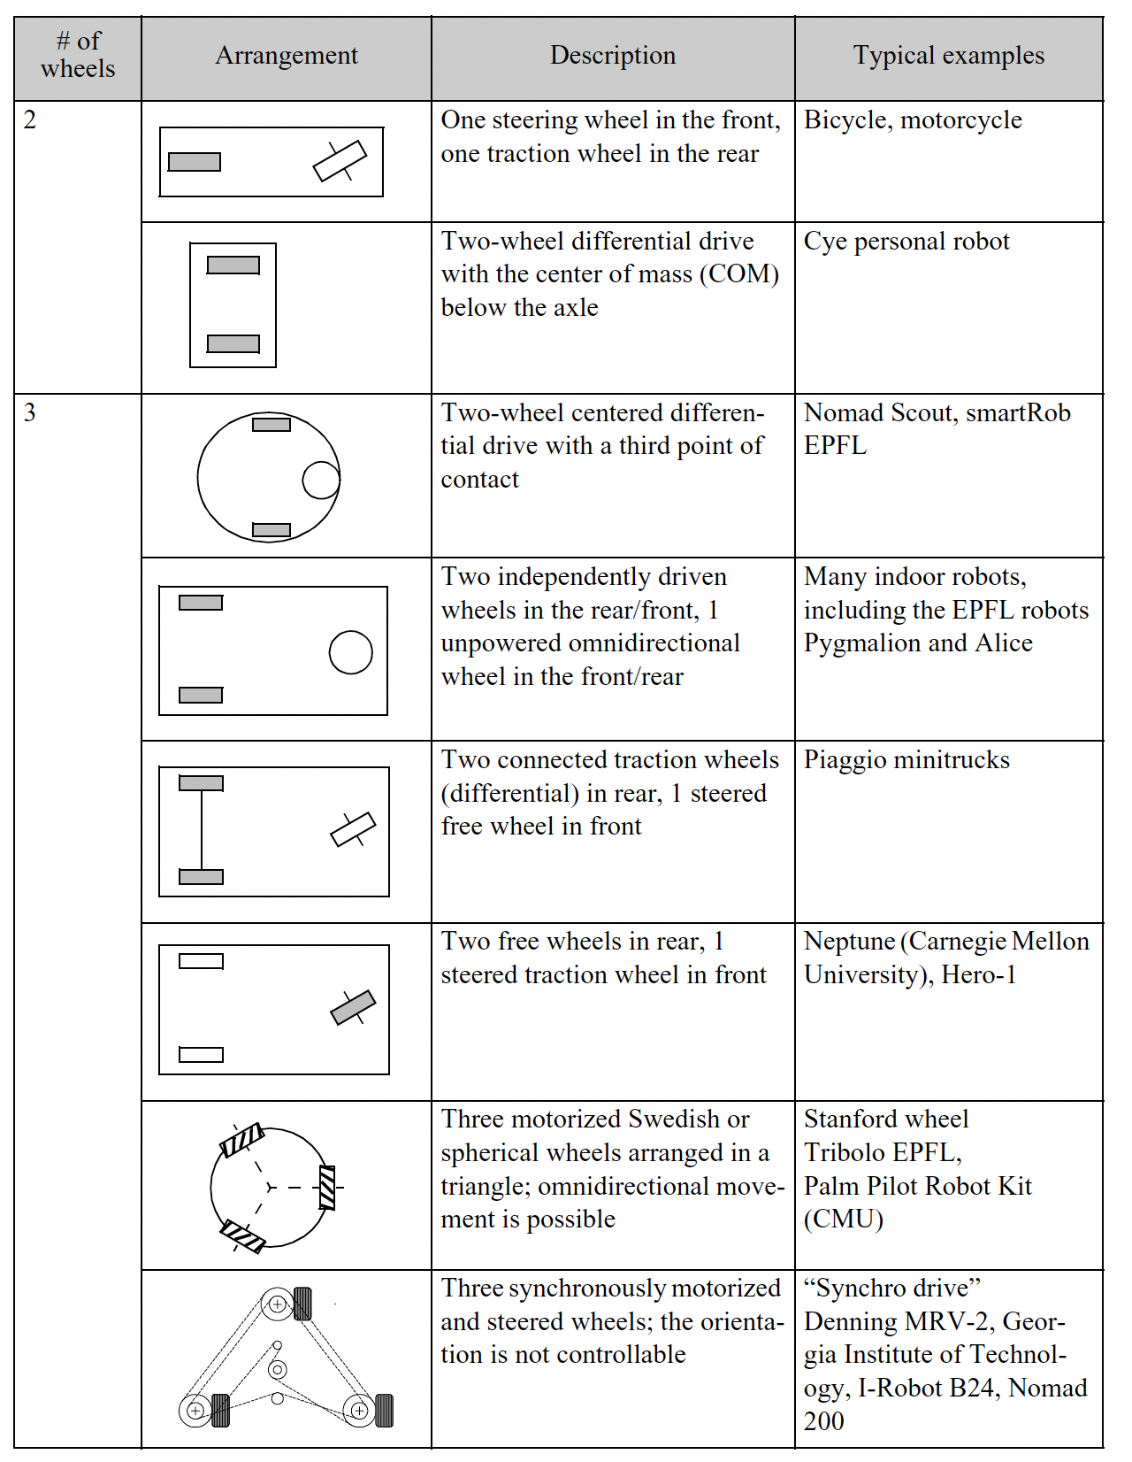
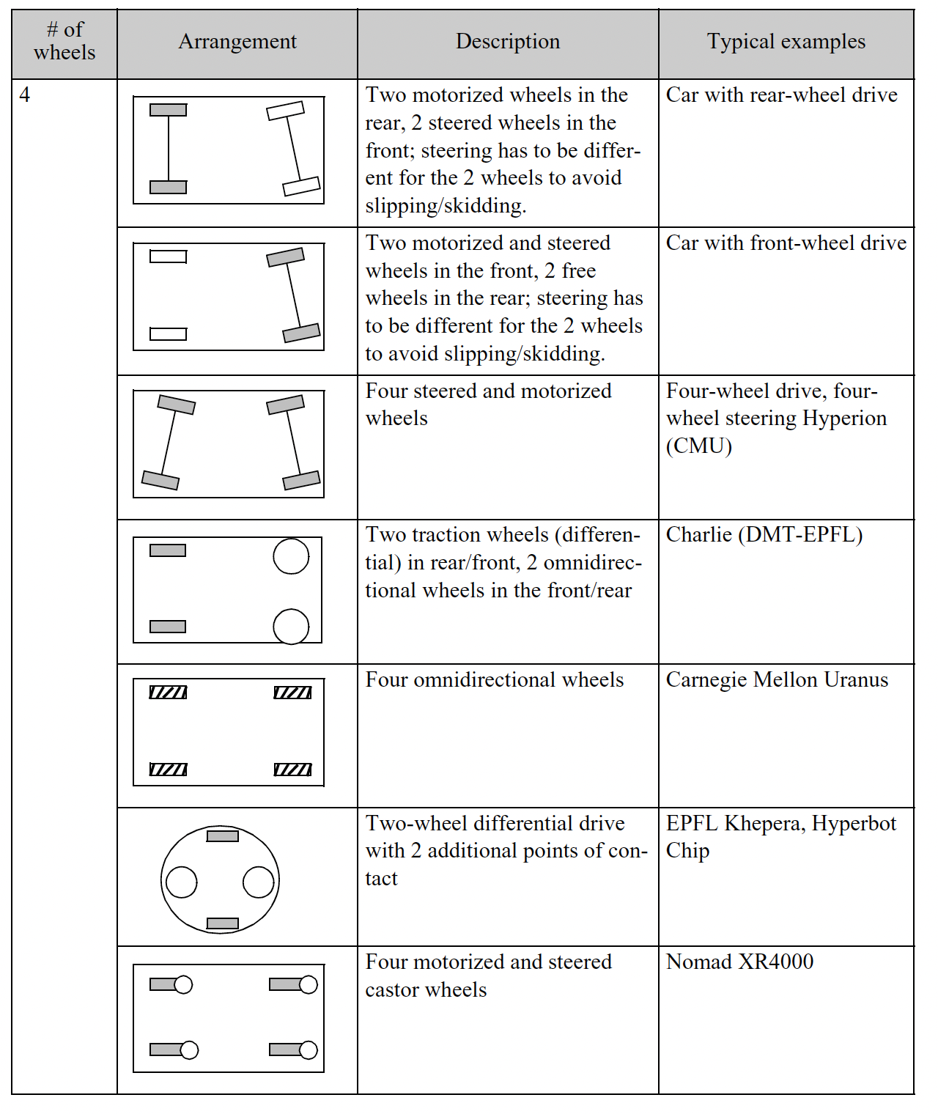
Pillars of Robotics: Action
Action

Slide 8
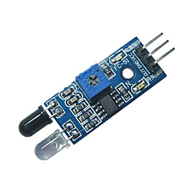
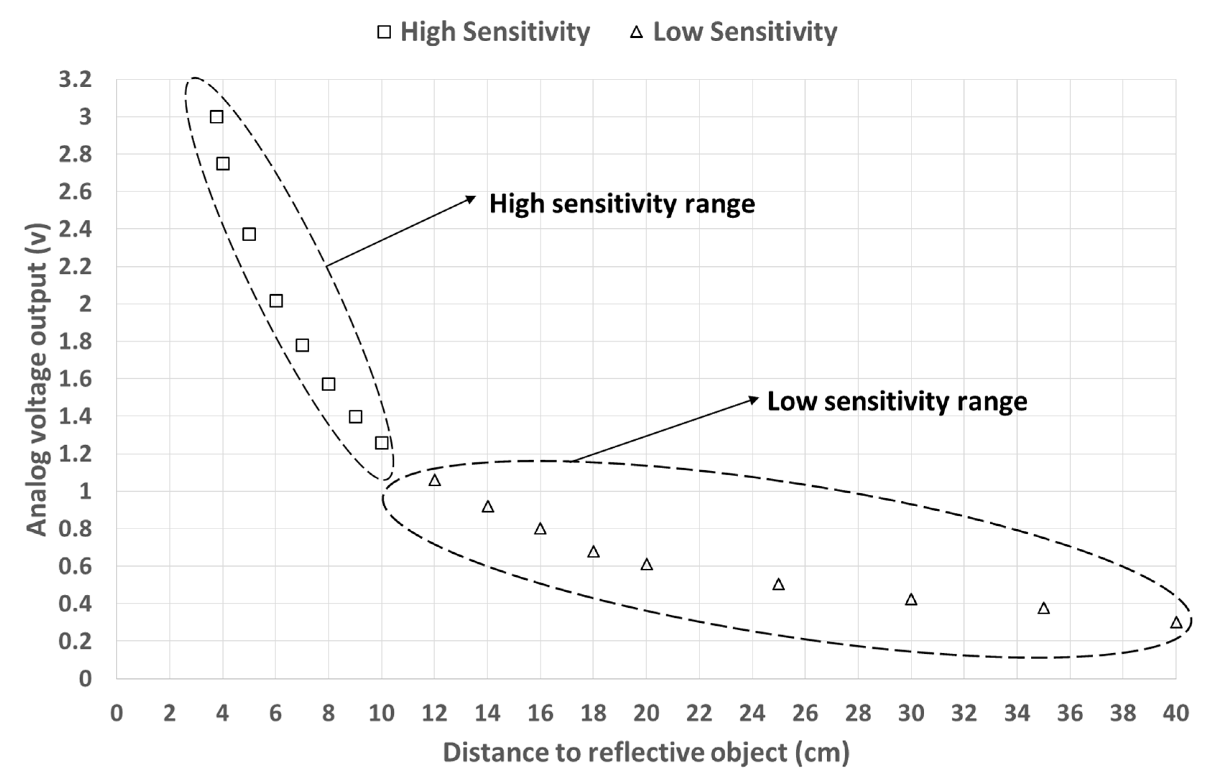
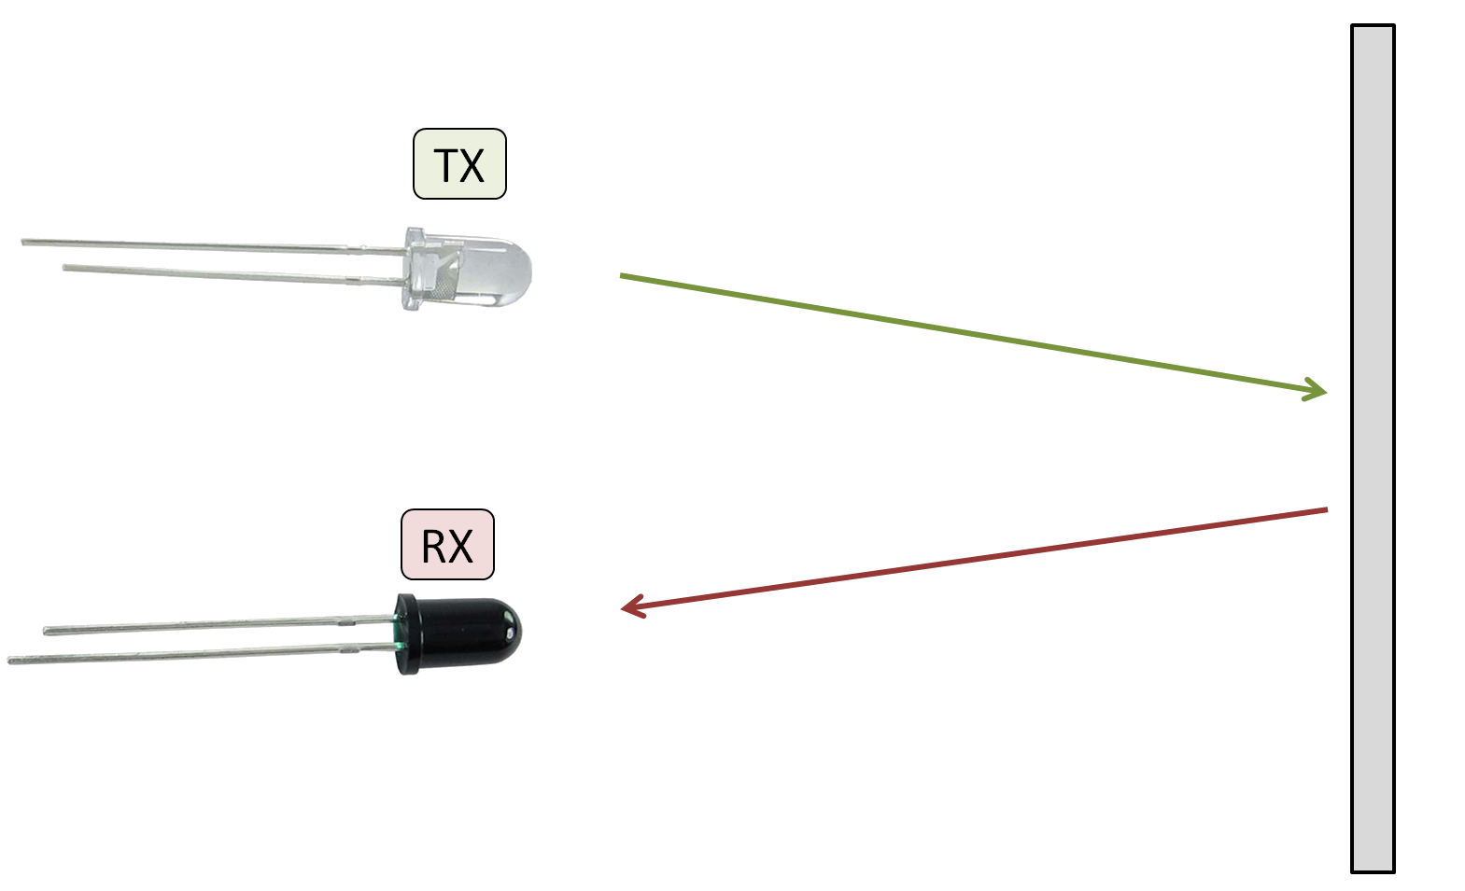
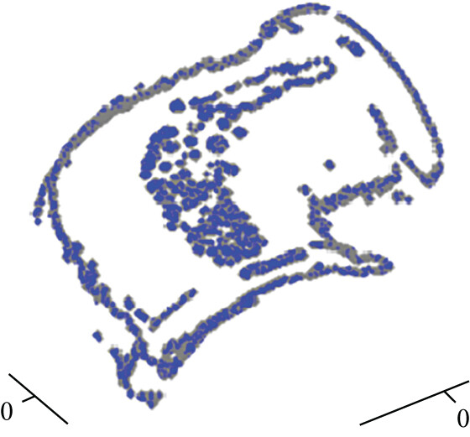
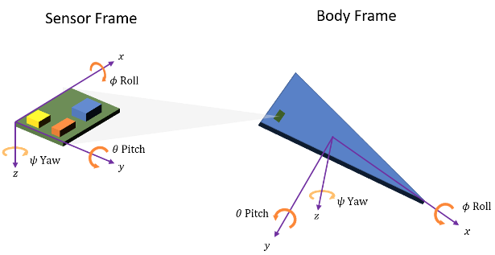
Pillars of Robotics: Perception
Perception
Physics
Calibration
Referencing
Processing

Slide 9
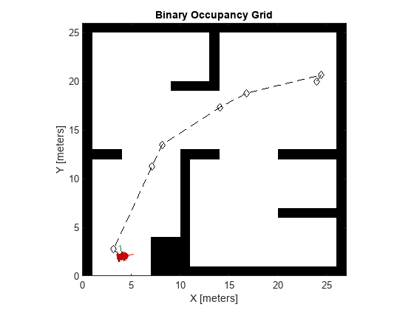
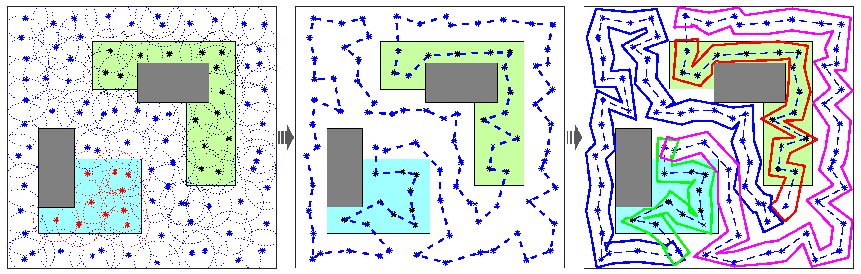
Pillars of Robotics: Intelligence
Motion Planning
Processing
Intelligence
Collision avoidance, coverage targets, …

Slide 10
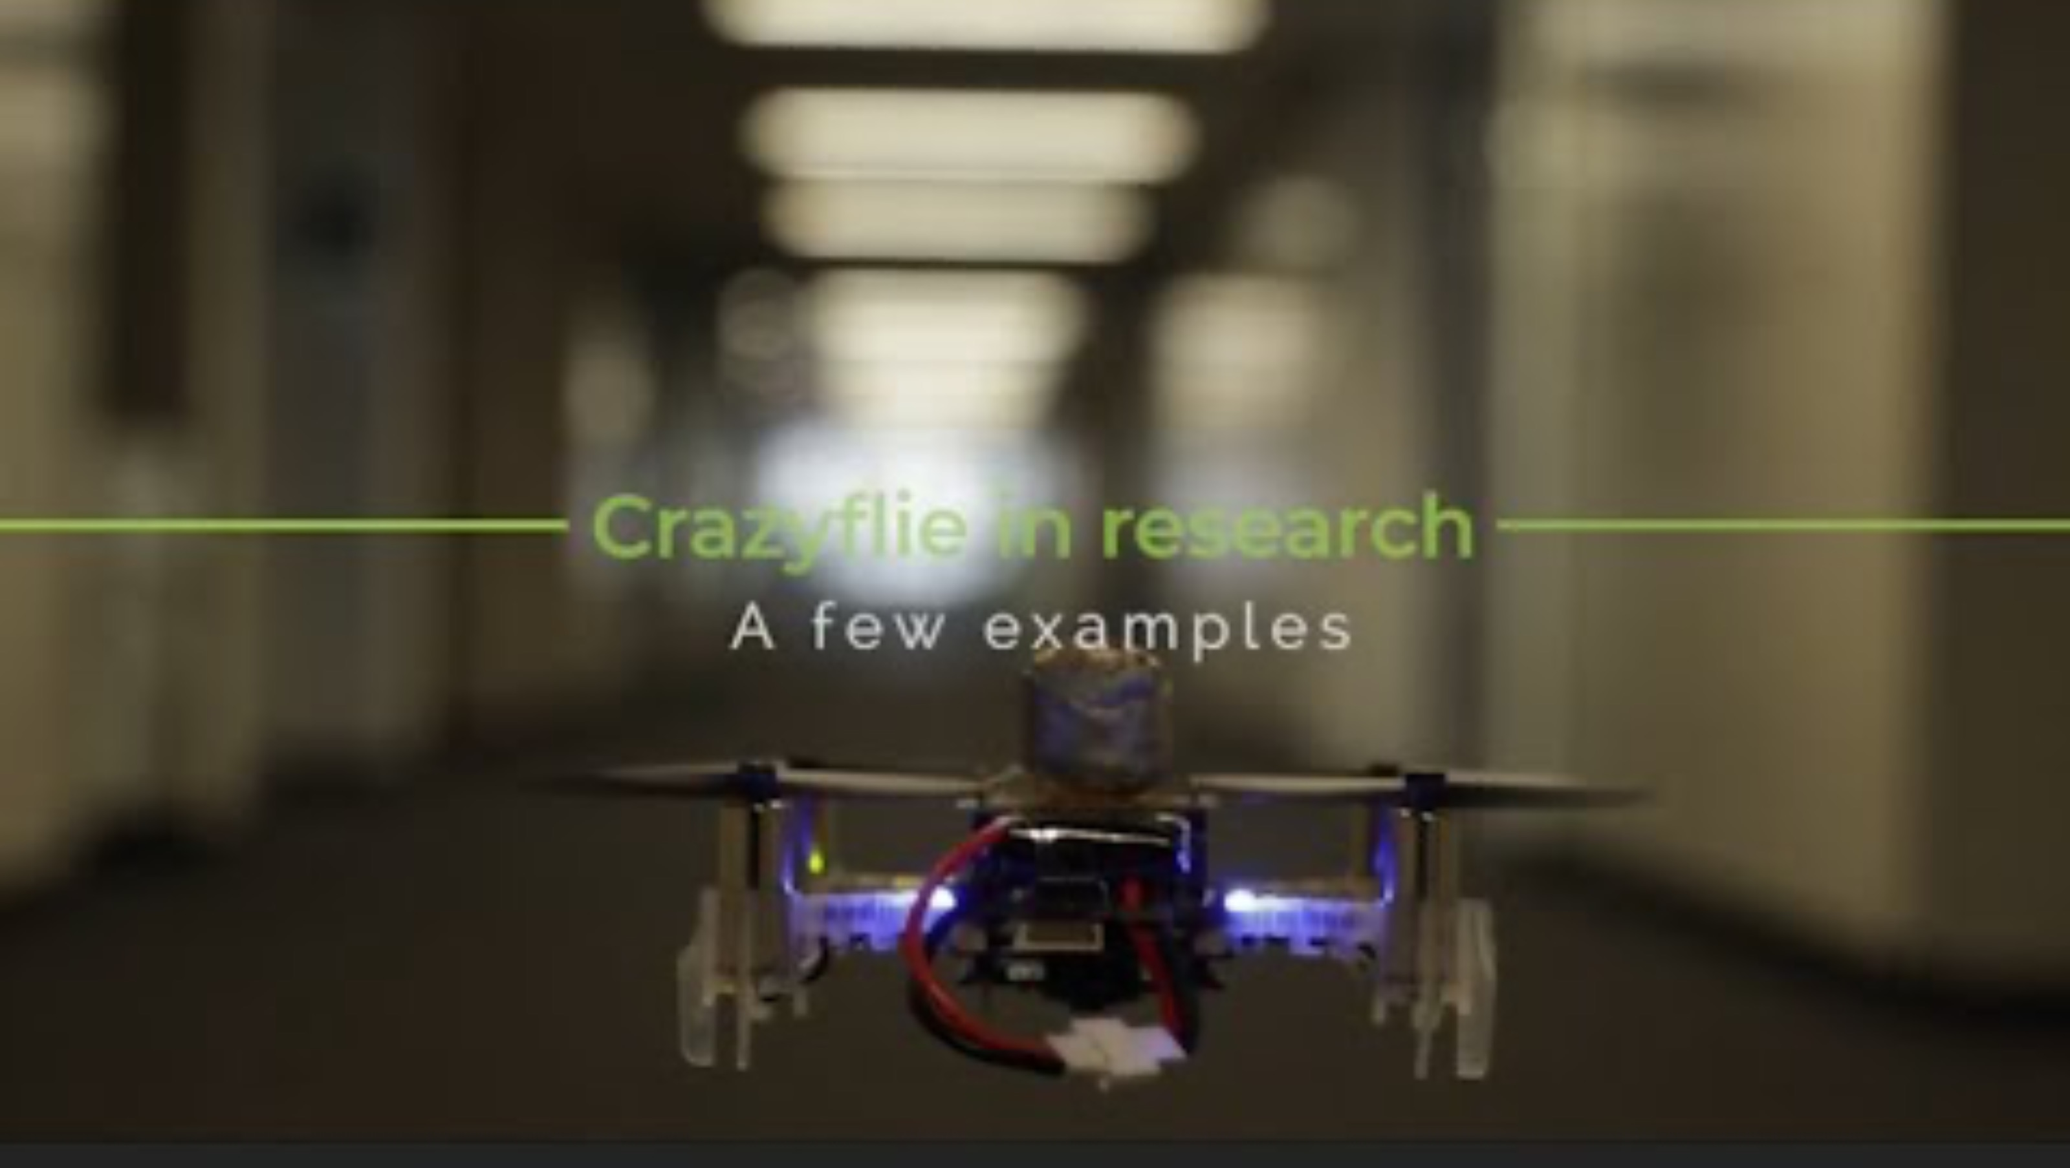
Pillars of Robotics: Intelligence
Intelligence

Slide 11
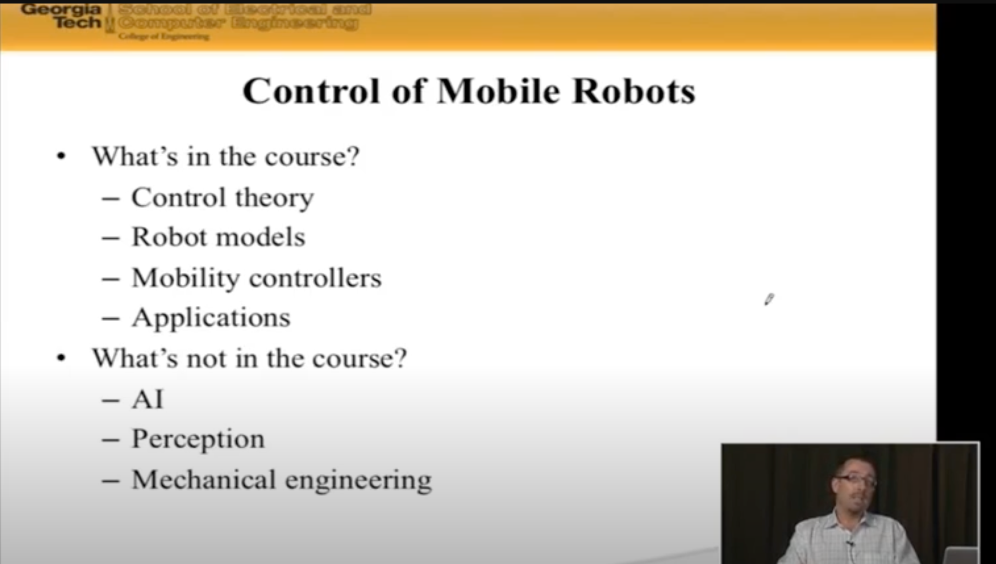
Pillars of Robotics: Not One Course of Material
Magnus Egerstedt, Georgia Tech (now CoE Dean at UC Irvine)

Slide 12
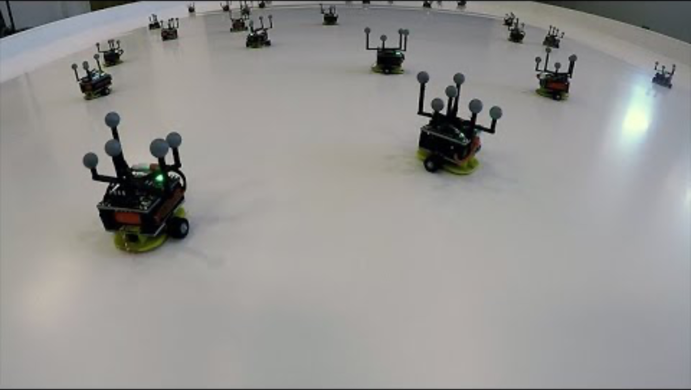
The Robotarium: Swarms in the Cloud

Slide 13
Pillars of Robotics: No “Clean” Boundaries
Encoders connect sensing to action.
Intelligence underpins all control and signal processing.
Action
Complex systems have hierarchy of closed system blocks, so robots are really composed of lots of little complex multi-domain building blocks. (see TurtleBot, to follow)
Perception
Intelligence

Slide 14
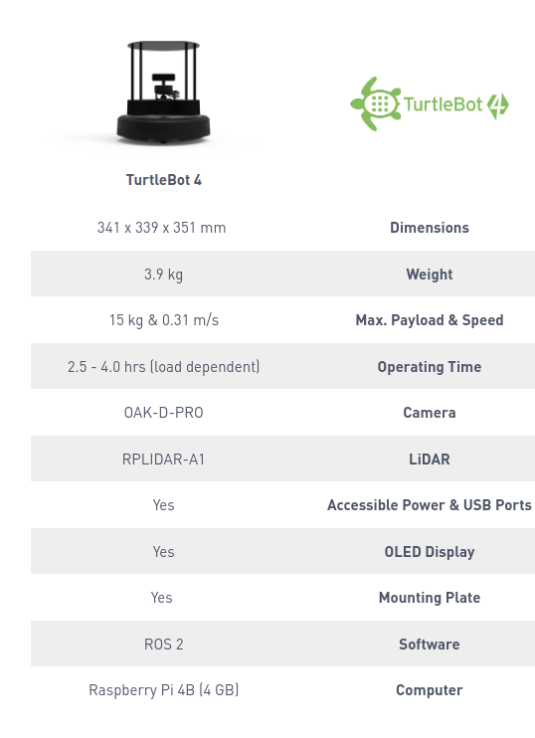
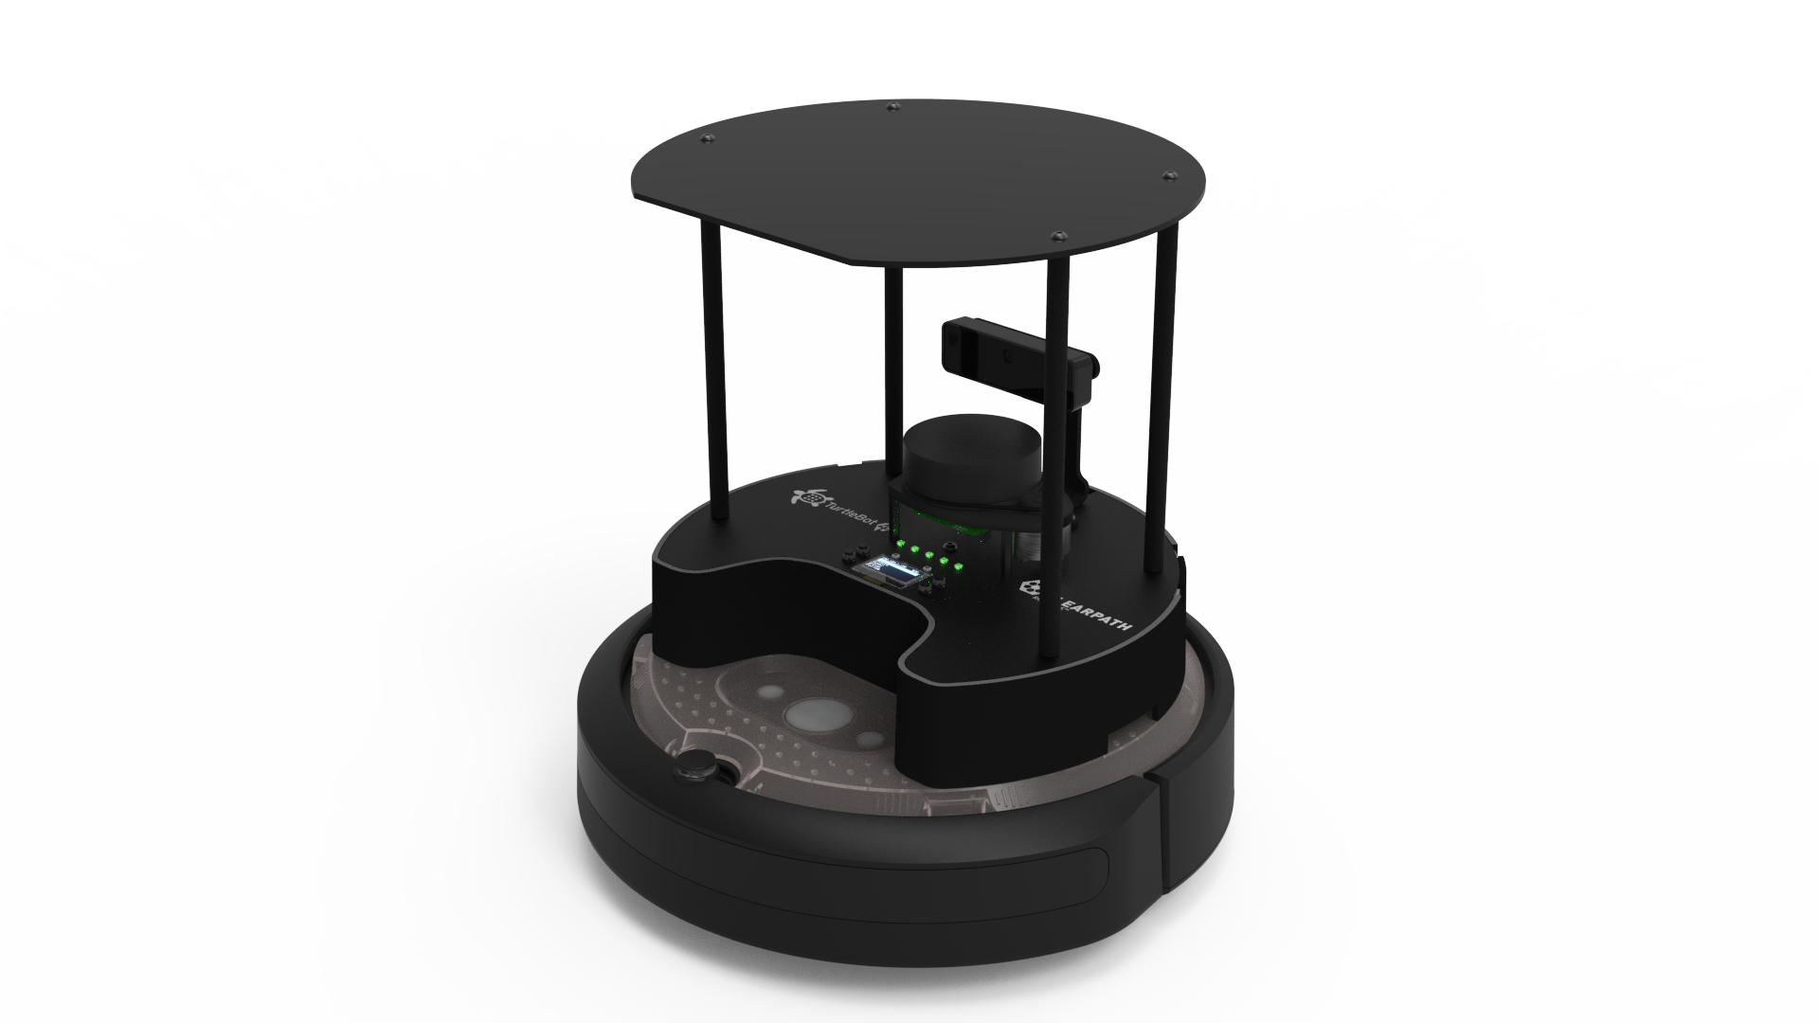
Case Study: The TurtleBot
TurtleBot 4

Slide 15
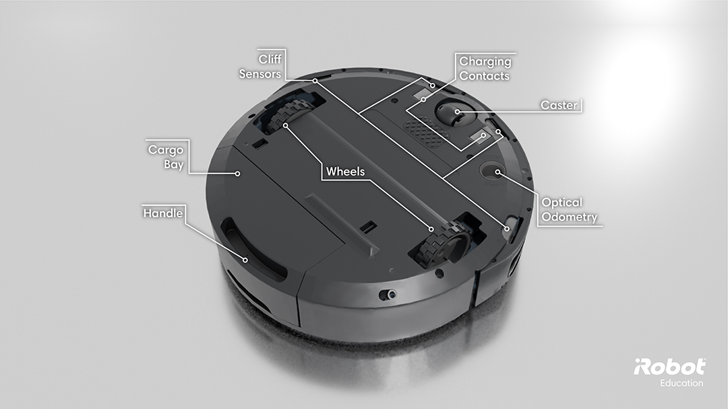
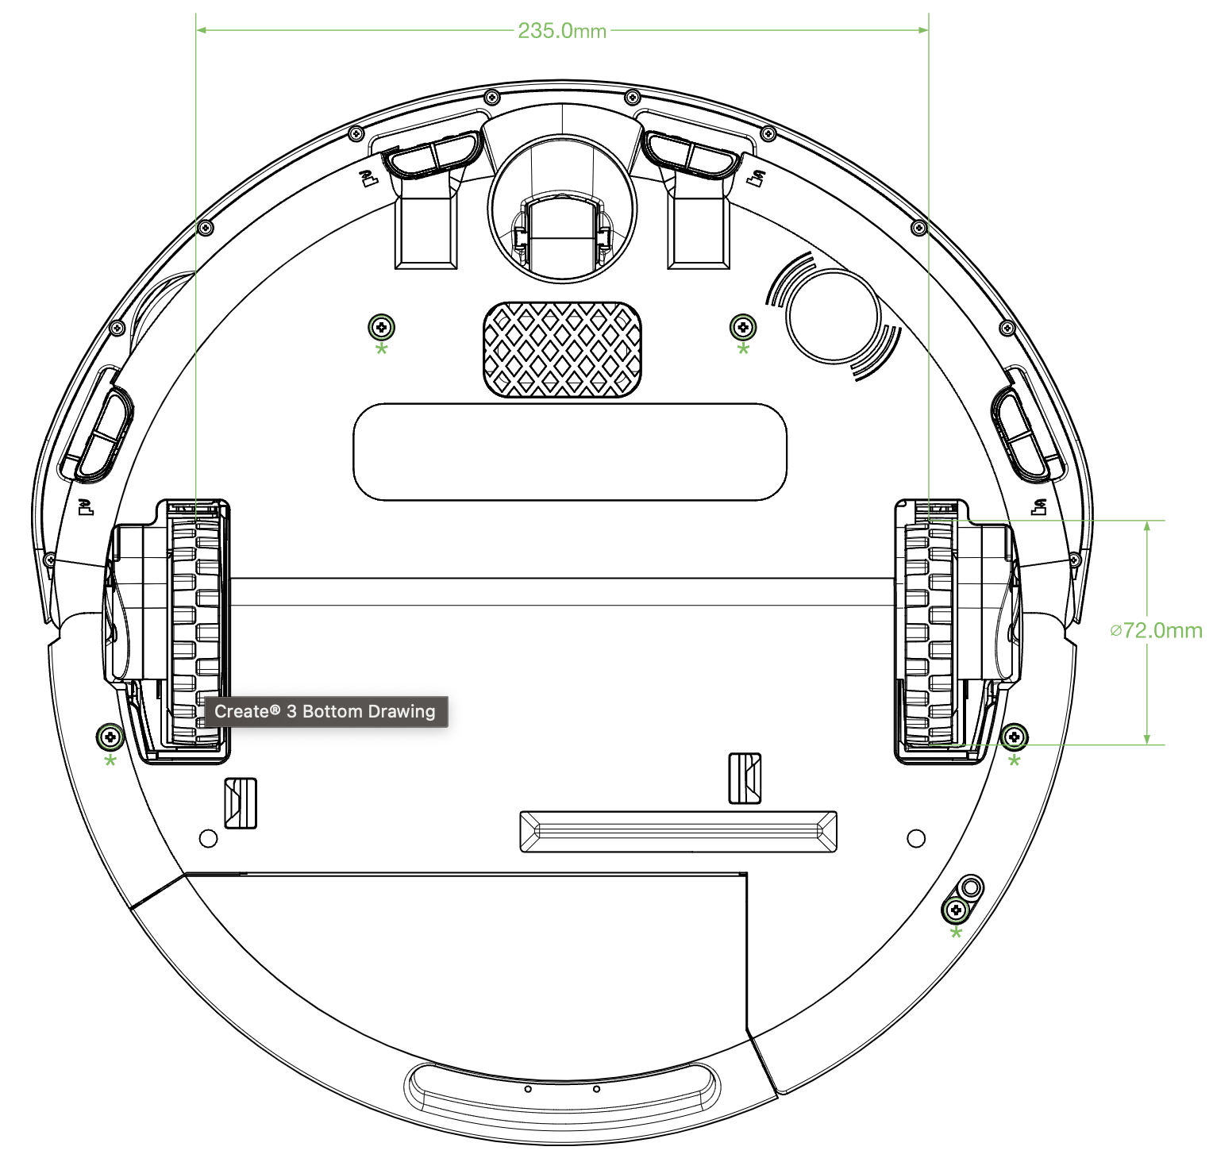
Case Study: The TurtleBot: Action
Mobility base hardware
iRobot Create 3

Slide 16
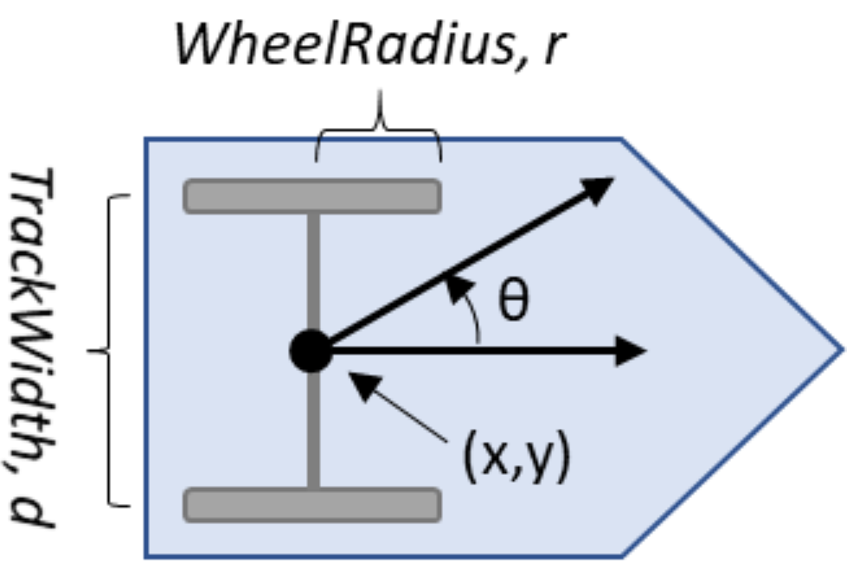
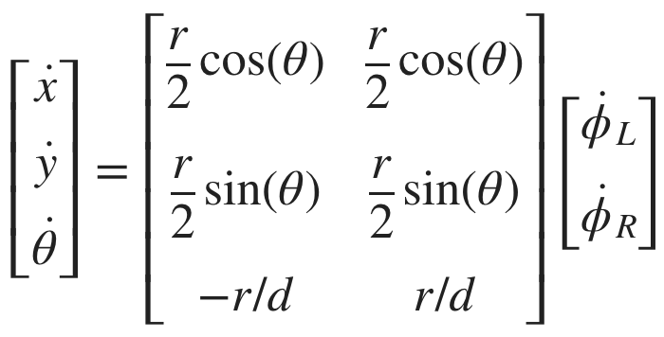
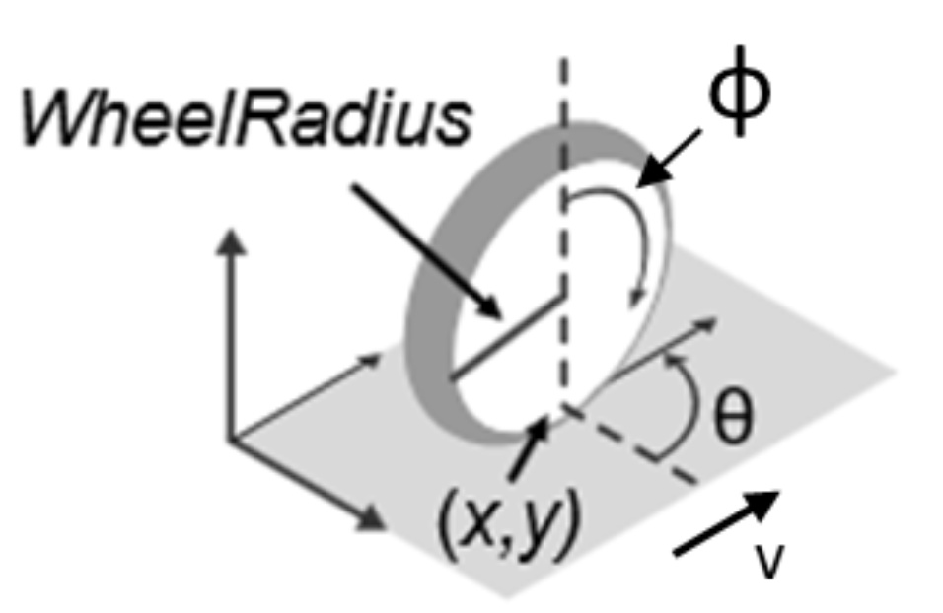
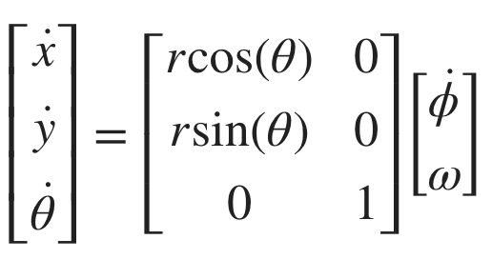
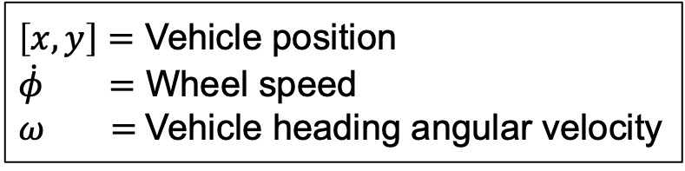
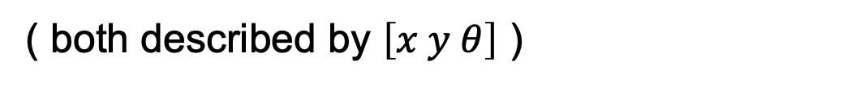
Case Study: The TurtleBot: Action
Simple Differential Drive Model
$\left[x, y\right]=$ Vehicle position
$\dot{φ} =$ Wheel speed
$ω =$Vehicle heading angular velocity
( both described by $\left[x y θ\right]$ )
Unicycle Model

Slide 17
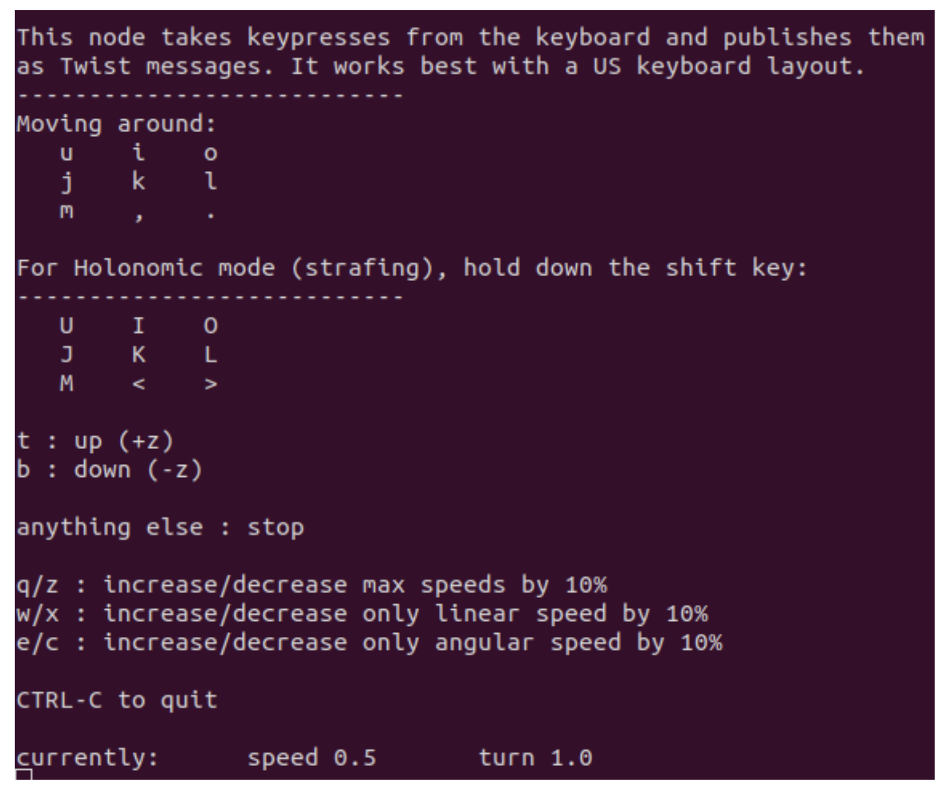
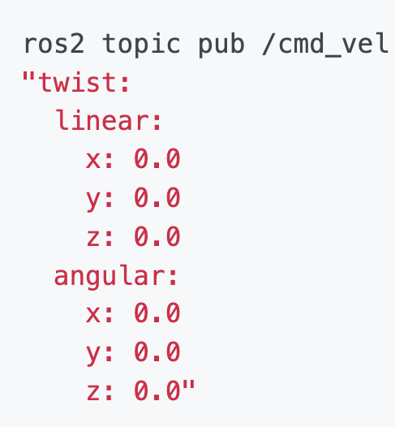
Case Study: The TurtleBot: Action
ros2 run teleop_twist_keyboard teleop_twist_keyboard
linear.x = drive forward / back
angular.z = rotate left / right

Slide 18
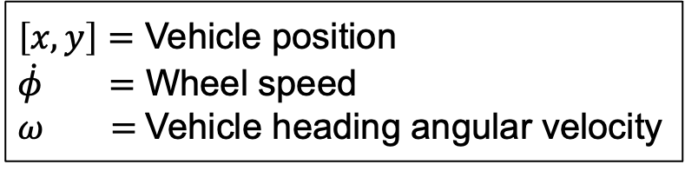
Case Study: The TurtleBot: Action
Simple Differential Drive Model
$\left[x, y\right]=$ Vehicle position
$\dot{φ} =$ Wheel speed
$ω =$Vehicle heading angular velocity
linear.x = drive forward / back
angular.z = rotate left / right
kinematic model
wheel speed setpoints
/cmd_vel

Slide 19
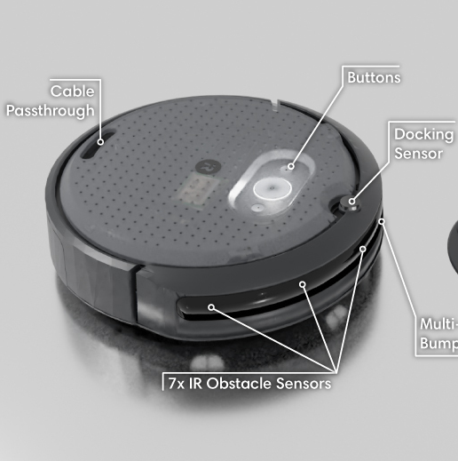
Case Study: The TurtleBot: Perception
Not shown: 9-axis IMU, wheel encoders

Slide 20
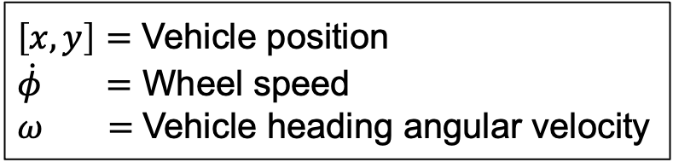
Case Study: The TurtleBot: Perception
kinematic model
wheel speed setpoints
/cmd_vel
What information do we need?
$\left[x, y\right]=$ Vehicle position
$\dot{φ} =$ Wheel speed
$ω =$Vehicle heading angular velocity

Slide 21
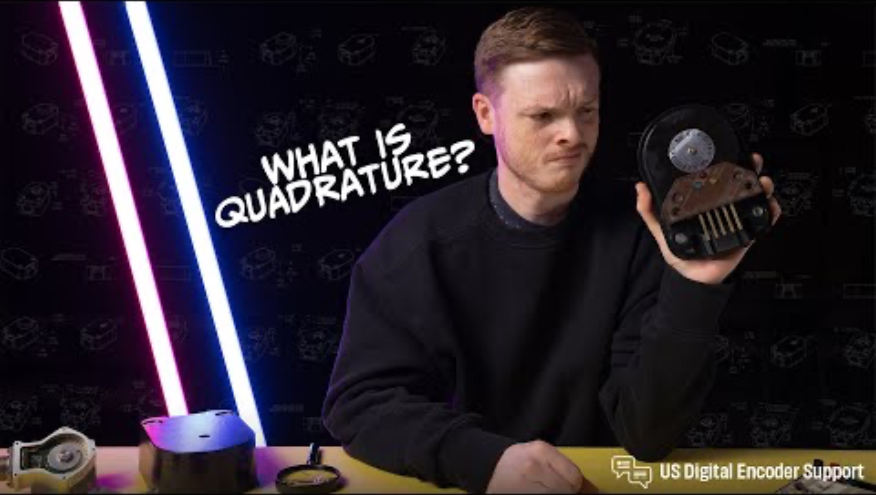
Case Study: The TurtleBot: Perception
Wheel speed? Wheel encoders.

Slide 22
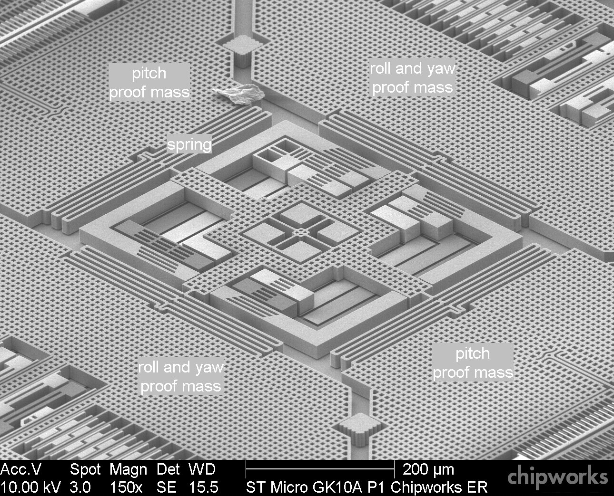
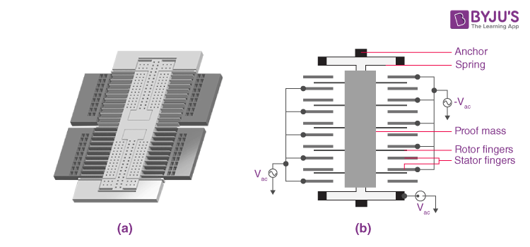
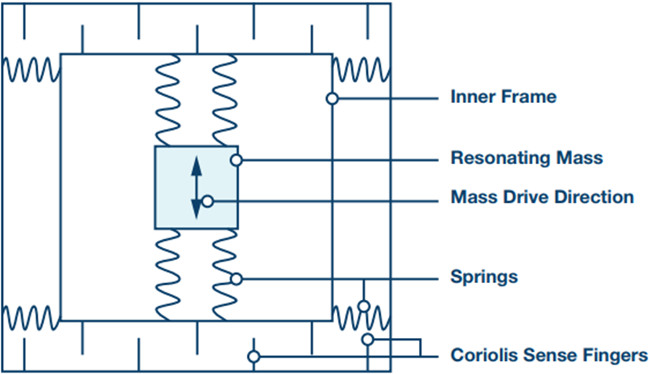
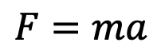
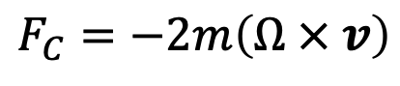
Case Study: The TurtleBot: Perception
Heading angle? IMU.
“6-axis IMU” = Accelerometer, gyroscope. “9-axis IMU” = Accel., gyro., magnetometer.
Accelerometer
Gyroscope
$$F=ma$$
$$F_{C}=−2m\left(Ω × v\right)$$

Slide 23
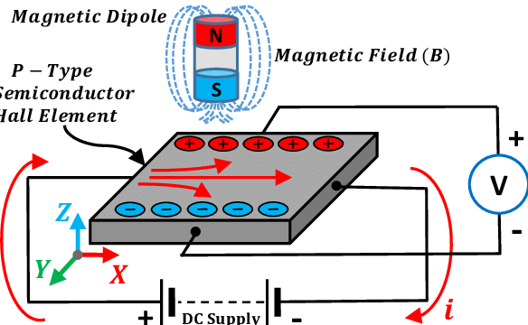
Case Study: The TurtleBot: Perception
Heading angle? IMU.
“6-axis IMU” = Accelerometer, gyroscope. “9-axis IMU” = Accel., gyro., magnetometer.
Magnetometer
aka “compass”

Slide 24
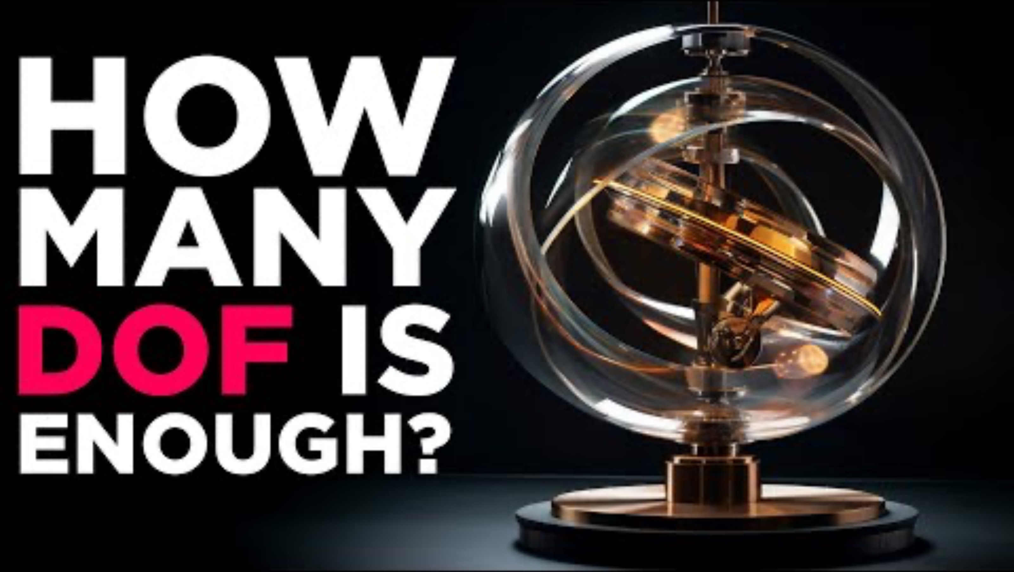
Case Study: The TurtleBot: Perception
Heading angle? IMU.
“6-axis IMU” = Accelerometer, gyroscope. “9-axis IMU” = Accel., gyro., magnetometer.

Slide 25
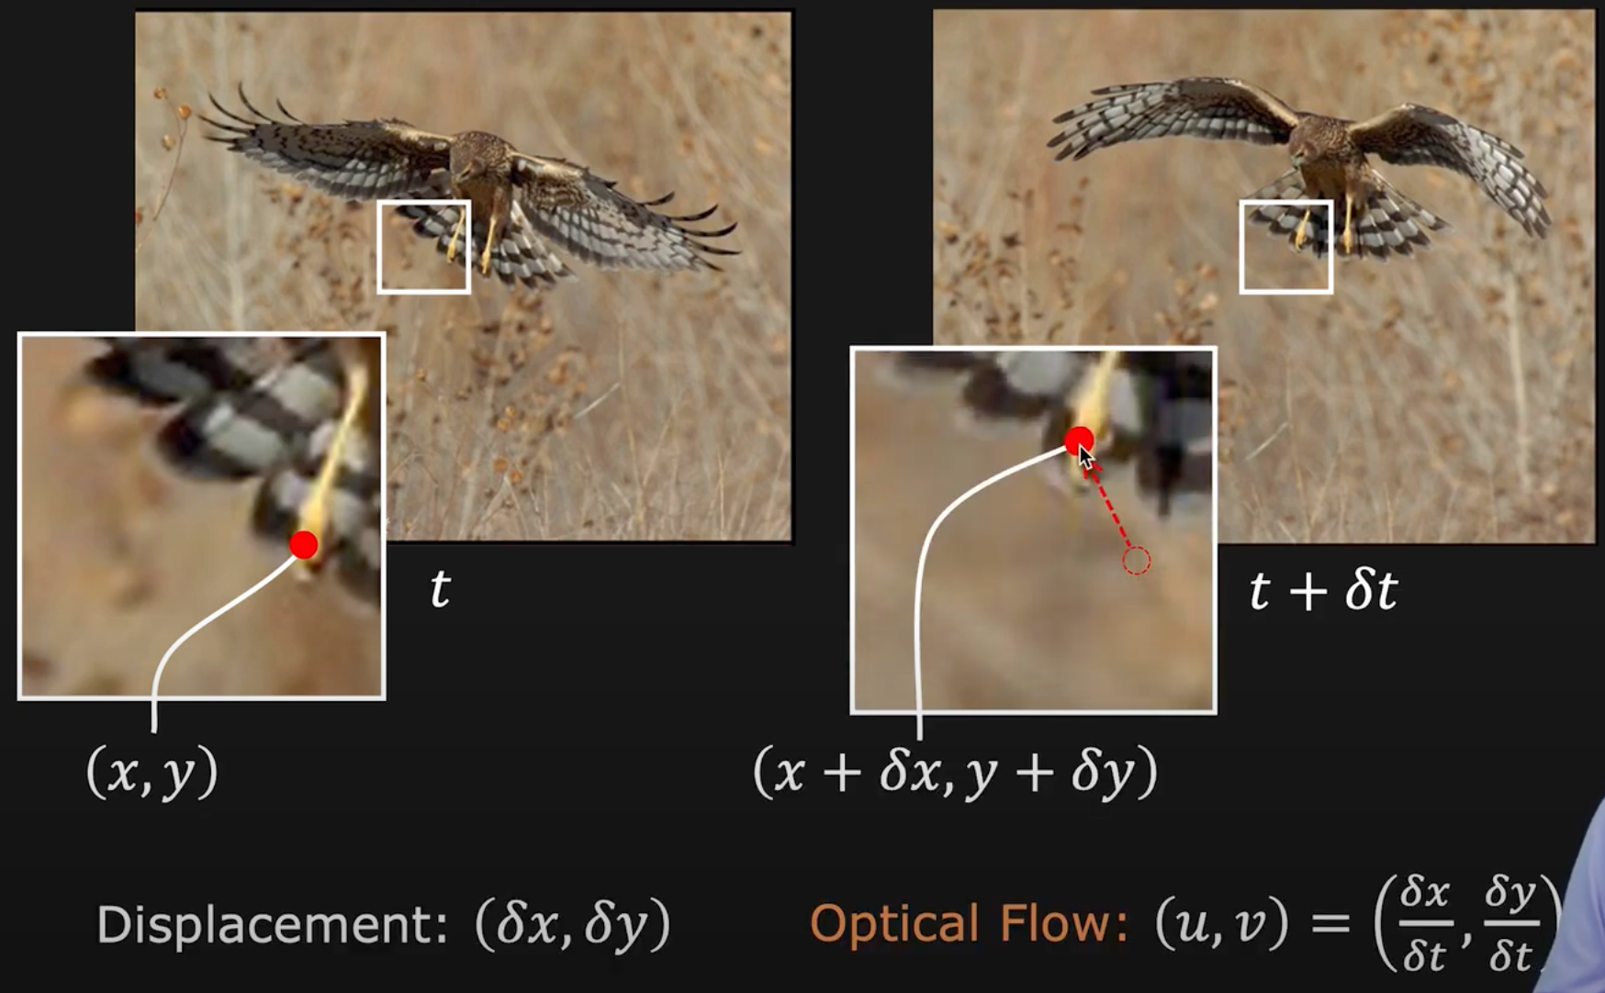
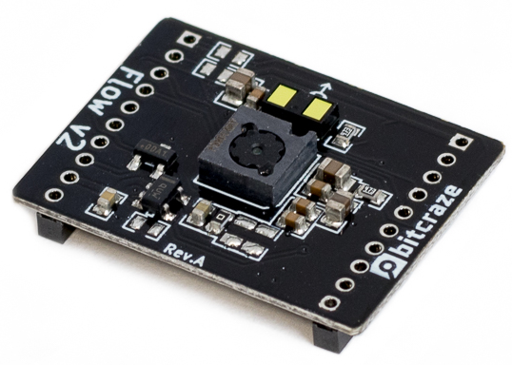
Case Study: The TurtleBot: Perception
Change in position? Optical flow.
Major assumptions: constant pixel intensity,
displacement and time step are small
Requires:
camera calibration,
feature recognition

Slide 26
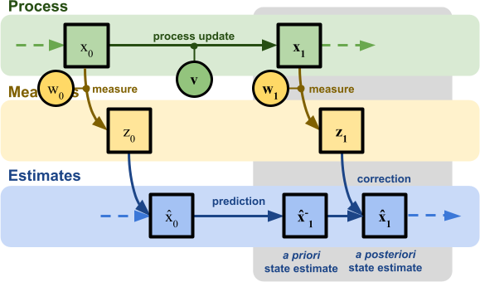
Case Study: The TurtleBot: Perception
Extended Kalman Filter (EKF)
Alan Zucconi
Note: in reality, we rely on sensor fusion between all three modules!
e.g., optical flow can also give rotational velocity to fuse with IMU;
integral of accelerometer data can give linear velocity to fuse with flow

Slide 27
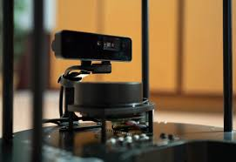
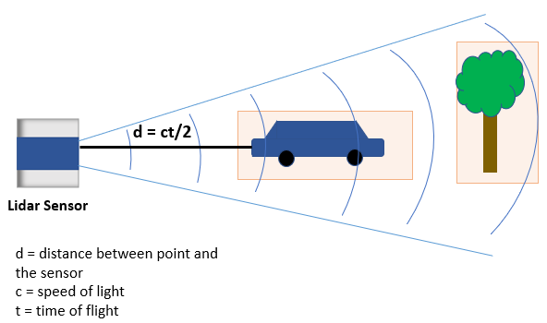
Case Study: The TurtleBot: Perception
Light Detection and Ranging
(ToF range-finding)

Slide 28
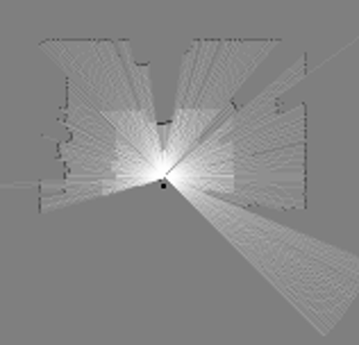
Case Study: The TurtleBot: Perception
Pointcloud
Light Detection and Ranging
(ToF range-finding)

Slide 29

Case Study: The TurtleBot: Perception
SLAM
(connects all three pillars)
LiDAR Slam

Slide 30

Case Study: The TurtleBot: Perception

Slide 31

Case Study: The TurtleBot: Perception
Visual Slam

Slide 32

Case Study: The TurtleBot: Intelligence
Onboard: Raspberry Pi 4 (4GB)

Slide 33

Case Study: The TurtleBot: Intelligence
ROS2: pub/sub model, modular
e.g., the LiDAR “node” publishes
distance information
Note: “services” are response driven,
not pub/sub like topics
Onboard: Raspberry Pi 4 (4GB)

Slide 34

Case Study: The TurtleBot: Intelligence

Slide 35

Swarm-on-a-Stick
We will create an open-source swarm robotics kit for education, from scratch.

Slide 36
693H Robotic Subsystems
Motors, drive electronics, encoders, PID controllers, top-down tracking
Sensor suite (IMU, prox.), calibration code, general IO (buttons and LEDs)
Mobility
Perception
Compute and Power
Control and Planning
Battery and charging, wireless comms, GPIO and power distribution routing
microROS, ROS2, Gazebo simulation, enclosure design
Mechanics / Prototyping
Coding
PCB Design

Slide 37


693H Robotic Subsystems
Each team (besides Control & Planning) designs their own PCB + chassis section
Integration challenges: which signal lines route through? how to connect chassis?

Slide 38

Subsystem Group Formation
Form groups of ~4 for each of the four subsystems:
Mobility, Perception, Compute and Power, Control and Planning
Suggestions:
Interested in more coding / ROS?
Control and Planning
Interested in more mechanical design?
Mobility
Interested in more PCB layout?
Perception, Compute and Power
To do today:
Send me an email (one per group, everyone cced): subject: [693H] Mobility Group, body: your names, at least one time you have each blocked off to work per week, and how your group will primarily communicate with each other (e.g., discord, email).

Slide 39

Course Schedule Reminder
Astound the Class 1 --- signups and slides posted on website
I will respond to subsystem group emails with additional info for Design Review 1
We don’t meet for a week: do the Readings!
Some course slots opened up: feel free to recruit a friend

